Slide 1


NewsVerse
Tuesday, October 8, 2024
NEWSVERSE

Slide 2



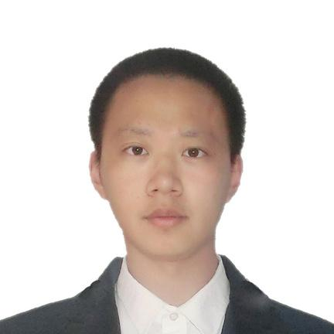

NewsVerse
Tuesday, October 8,2024
ROLES
Damanjit Singh
Abby Gualda
Stephen Yang
Dewei Wang
Yuhang Wang
NewsVerse Team

Slide 3

NewsVerse
Tuesday, October 8, 2024
Project Scope
The project involves developing an unbiased news aggregation platform that curates content from multiple sources, ensuring diverse perspectives on current events.
The app will aggregate content from various APIs, offering comprehensive updates across a range of categories including national news, business, sports, international relations, weather, stocks, technology, and art.
With real-time updates and news feeds, the platform will enhance user engagement by allowing users to stay informed on topics of their interest in an impartial manner. We will potentially be utilizing AI semantic analysis, the platform will filter news based on levels of bias, delivering balanced coverage.
Important Features
News Aggregation
Real-Time Updates
Search and Filter Functionality
Multi-Source Comparison
Third-Party Integrations
(Optional) Personalized News Feed
page 01

Slide 4
NewsVerse
Tuesday, October 8, 2024
Goals
Provide Unbiased News Coverage-
Aggregate content from multiple sources and deliver news that minimizes bias and promotes balanced perspectives
Enhance Media Literacy-
Promote critical thinking by reducing misinformation through bias avoidance and transparency in reporting
Foster Informed Engagement-
Empower users with customizable news feeds and live updates, tailored to their interests, ensuring they stay informed on relevant topics as well.
Create a Diverse News Ecosystem-
Cover a broad range of categories, including politics, business, technology, and culture, to encourage understanding and empathy across global issues.
Simplify News Access and Experience-
Offer a user-friendly, one-stop platform that consolidates news from various sources, making it easy for users to stay updated without navigating multiple sites or apps
page 03

Slide 5

NewsVerse
Tuesday, October 8, 2024
Target Users
Individual News Consumers
Ideal for those who seek daily news updates from a variety of sources to gain a well-rounded, unbiased perspective.
Users who value balanced reporting and want access to diverse viewpoints will find this platform especially useful.
Busy Professionals
Designed for professionals who need to stay informed but don’t have time to sift through multiple sources.
No information overload will be achieved by designing the UI in a manner that has a section at the top of the web page with rolling live news with at most 6-10 rows of news.
News Enthusiasts and Analysts
People who actively engage with news, enjoy comparing stories from multiple sources, and analyze media biases.
The multi-source comparison feature allows them to critically evaluate reporting on key topics.
Content Creators and Bloggers
Writers, bloggers, and content creators who rely on up-to-date news and diverse sources for generating content.
The platform can be an essential tool for gathering news quickly and efficiently from multiple categories and perspectives.
page 02

Slide 6

NewsVerse
Tuesday, October 8, 2024
Responsibilities
Full Stack Developer, UI-UX design
Scrum Master, UI-UX design, Documentation
Back-End Developer, QA
Front-End Developers
Design and develop the architecture of the product on the basis of functionality requirements.
Review code and integrate components.
Schedules team meetings and manages Jira stories and tasks.
Oversees user experience design while ensuring a smooth application development process.
Prepares software documentation, including design plans, requirements, and analysis.
Git version control.
Implement the usage of robust API’s and functionalities using Python.
Database development and storage.
Quality assurance and testing.
Create a responsive web interface using React, Tailwind and Material-UI
page 07

Slide 7
NewsVerse
Tuesday, October 8, 2024
Functional Requirements
Provide Top News Stories in a banner like fashion
Widgets
Categories
Headline Page
Summary Page
Sources
Real Time News Updates
Search functionality
page 05

Slide 8
NewsVerse
High Level Project Requirements
Tuesday, October 8, 2024
Non - Functional Requirements
System’s Quality Attributes:
The website should be able to respond quickly to user requests, for example, page loading time should be within 3 seconds.
Backend services need to efficiently integrate and process data from different sources to ensure real-time and accurate data.
Optimize for high concurrency access to ensure stable operation even during peak user access periods.
Compliance and Legal Requirements:
Comply with relevant data protection regulations (such as GDPR).
Ensure that all news content and references comply with legal requirements for copyright and intellectual property.
Scalability
The website architecture should support both horizontal and vertical scalability to accommodate the increase in user volume and data volume.
Use modern technologies such as micro service architecture to independently expand different parts of the website.
Data Integration and Management:
Ensure that data integrated from various sources can be accurately classified, stored, and retrieved.
Implement efficient data caching strategies to reduce database pressure and improve response speed.
Disaster Recovery and Backup:
Develop and implement a disaster recovery plan to ensure rapid service recovery when the data center failure.
Regularly backup website data and configuration to ensure quick recovery in case of data loss or damage.
page 05

Slide 9
NewsVerse
Tuesday, October 8, 2024
Updates on GUI or API Designs
High level Interface API Design
Front-end React
The communication with the backend will be via the REST API.
For the front-end design Material UI will be utilized.
The implementation of dynamic effect will be leveraged by GitHub
Data Design
The communication between front-end and back-end only involves reading the data from the database.
Each API endpoint follows the schemas of the tables in DynamoDB it requests. Validate the input and output to ensure it is aligned with the required formats.
The APIs have to handle errors and return it with the corresponding messages when it occurs.
Performance
Apply caching for frequently accessed endpoints and rate limitation to prevent over requesting to optimize performance.
Timeout limit on per API request.
Testing
Perform unit testing and integration testing to ensure the quality of the endpoint and its operation.
page 06

Slide 10
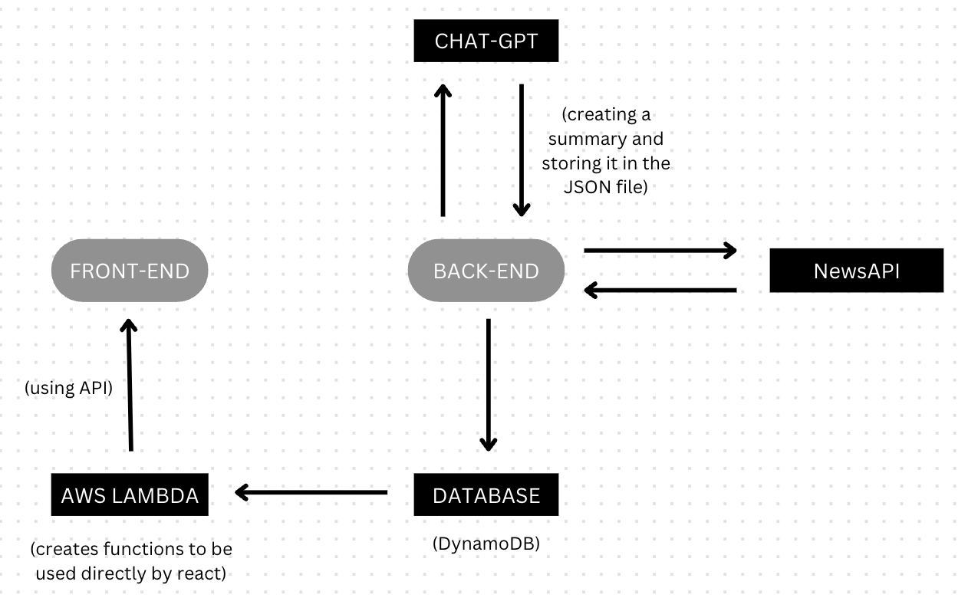
NewsVerse
Tuesday, October 8, 2024
Methodology
Workflow Explained:
The backend will call the News API to collect all the News Headlines and sources. ChatGPT is going to summarize all headlines and related articles; it will then provide a summary which will be stored in the database. This will allow our front end to display the data on the application. The API call will be used for communication between then Frontend and database. This allows for a reliable pipeline to properly and effectively upload the updated data.
page 04
Notes:
The provided workflow illustrates a system where news data is aggregated and processed through multiple layers. The back-end fetches news articles from an external NewsAPI and sends the data to ChatGPT, which generates summaries. These summaries are stored in a DynamoDB database as JSON files.
On the front-end, a React application fetches this summarized data through an API powered by AWS Lambda functions, which interact with the database. This enables real-time display of processed news content on the user's interface. The entire flow is designed for efficient data fetching, processing, and display using serverless architecture.

Slide 11
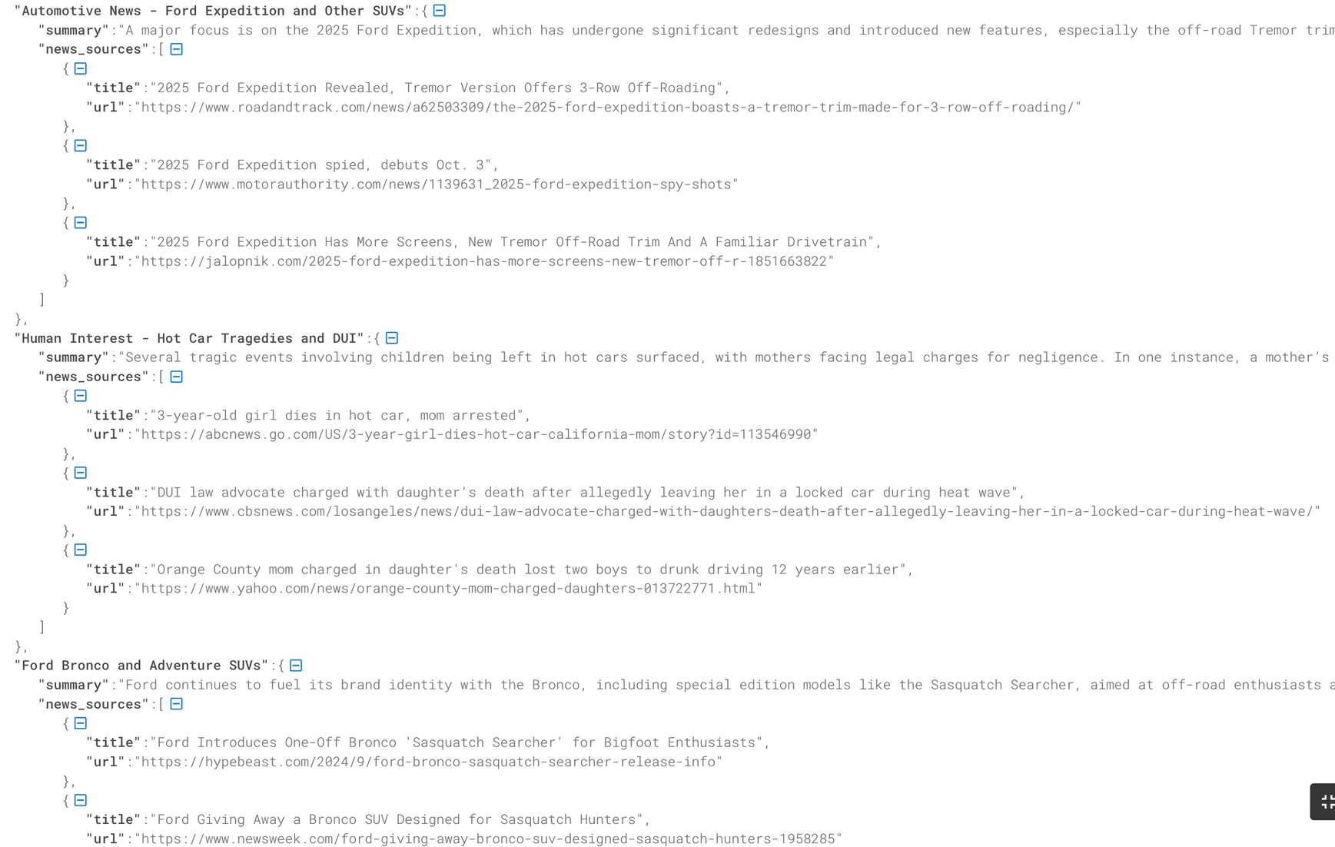

NewsVerse
Snapshot Demo
Tuesday, October 8, 2024
News API Business Headline:
The new Ford Expedition adds Android Automotive and half of the Lincoln’s panoramic screen
page 04

Slide 12
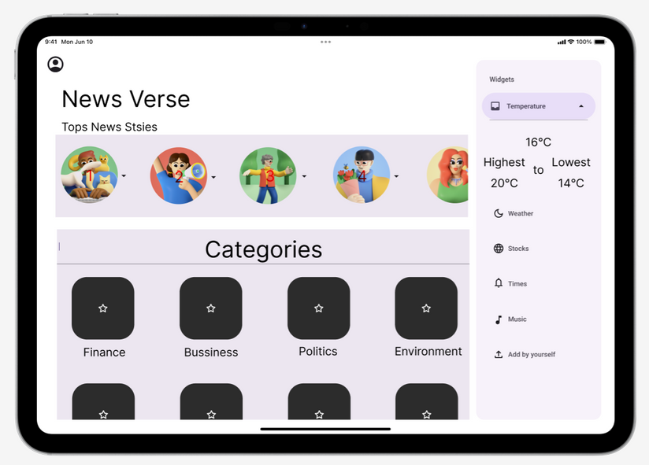
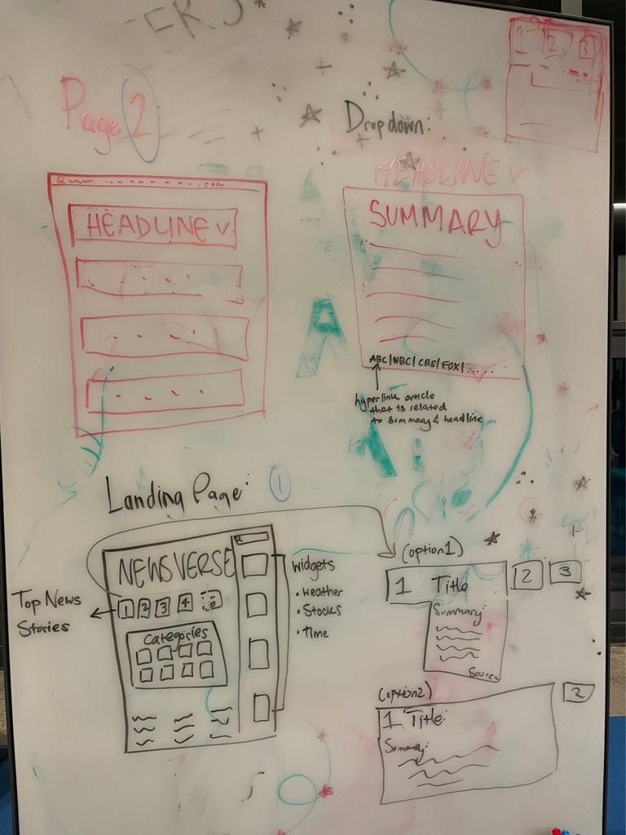
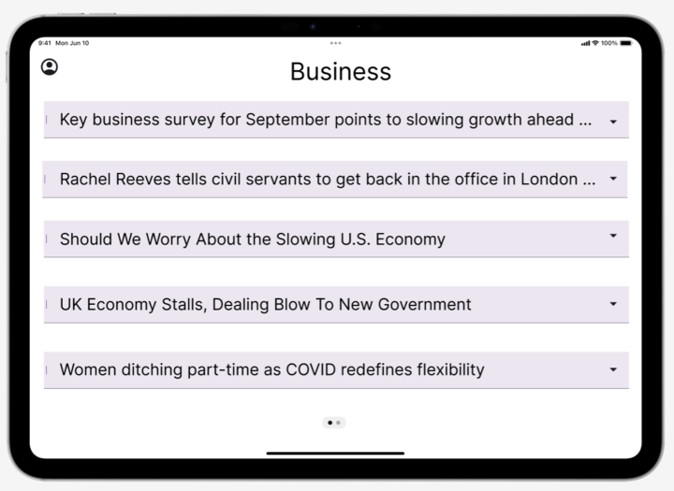
NewsVerse
Tuesday, October 8, 2024
Snapshot of Progress!
page 04

Slide 13
NewsVerse
Tuesday, October 8, 2024
Upcoming Project Milestones
1: Create a code base on VS Code
2: Make a basic frontend structure
3: Finalize the backend pipeline
4: Test the frontend - backend communication
5: Search and Filter Functionality
6: Final UI/UX Design and Front-End Development
7: Testing, Deployment, and MVP Release
page 06

Slide 14

NewsVerse
Tuesday, October 8, 2024
Thank you!
page 08

